Slide 1


BASAVARAJESWARI GROUP OF INSTITUTIONS BALLARI INSTITUTE OF TECHNOLOGY & MANAGEMENT Autonomous Institute Under VTU , Belagavi
TOPIC:
THEATRE ASSET MANAGEMENT POC
Team=6
Chaitra
SYEDA Afifa
Shwetha
Sinchana .M
Sneha

Slide 2
Introduction:
Theatre asset management in Python involves creating systems and tools to efficiently track and manage the various assets used in theatrical productions. This includes items such as costumes, props, sets, and lighting equipment. By utilizing Python's libraries and frameworks, we can develop applications to inventory assets, schedule usage, and manage maintenance.
KEY COMPONENTS:
Asset Inventory Management
Check-in/Check-out System
User Management
Production Management
Reporting And Analytics
Search And Filter Functionality

Slide 3
The purpose of building code:
Streamlined Asset Tracking Efficient Management: Automate the tracking of various assets (props, costumes, equipment) to reduce manual errors and time spent searching for items .
Real-Time Inventory: Maintain an up-to-date inventory of available and checked-out items, ensuring that everyone knows what’s available.
Improved Resource Utilization Maximize Usage: Identify which assets are frequently used and which are underutilized, enabling better resource allocation and decision-making .
Cost Efficiency: Prevent unnecessary purchases of duplicate items by keeping a clear record of what is available.
Enhanced Collaboration Role-Based Access: Different users (admins, stage managers, cast) can access relevant information based on their roles, improving communication and coordination .
Shared Access: Facilitate collaboration among team members, allowing for better planning and execution of productions.

Slide 4
Accountability and Responsibility Check-In/Check-Out System: Track who is responsible for each asset, ensuring accountability and reducing the likelihood of loss or damage .
Due Dates and Reminders: Set and manage due dates for asset returns, minimizing the risk of overdue items.
Data-Driven Insights Reporting and Analytics: Generate reports on asset usage, condition, and history, providing valuable insights for future productions .
Trend Analysis: Understand patterns in asset utilization, which can inform purchasing decisions and maintenance schedules.
User-Friendly Experience Simplified Processes: Create a user-friendly interface for easy asset management, reducing the learning curve for new users .
Accessibility: Make it easy for users to

Slide 5
The methods to implement the code on Theatre Asset Management:
Object-Oriented Programming (OOP)Classes and Objects: Create classes for assets, users, and productions to encapsulate related properties and methods.
Encapsulation: Keep asset details and operations within their respective classes.
User Authentication and Authorization Login System: Implement user authentication to ensure only authorized personnel can access certain features .
Role-Based Access Control: Define roles (e.g., admin, stage manager) to restrict access to sensitive functions.
Check-In/Check-Out Functionality Tracking System: Implement methods to track when assets are checked out and returned, including due dates.
Search and Filtering Search Functionality: Provide methods to search for assets based on criteria like name, condition, or type .
Filtering Options: Allow users to filter asset lists for better visibility.

Slide 6
Notification System Alerts: Implement a system to notify users of overdue items or low inventory levels through email or in-app notifications.
Reporting and Analytics Generate Reports: Create methods to generate reports on asset usage, inventory status, and trends.
The modules to implement the code on theatre asset management.
1.Core modules:
Authentication(login , logout)
Authorization(role-based access control)
User profiles(add , edit , delete)

Slide 7
2.Asset management:
Asset registration(add , edit , delete)
Asset categorization(E.g : props , costumes , set pieces)
Asset search and filtering
3.Inventory Management :
Stock tracking (quantity, location)
Asset check-in/check-out system
Low stock alerts and notifications
4.Scheduling:
Rehearsal and performance scheduling
Resource allocation (e.g., spaces, equipment)
Conflict detection and resolution

Slide 8
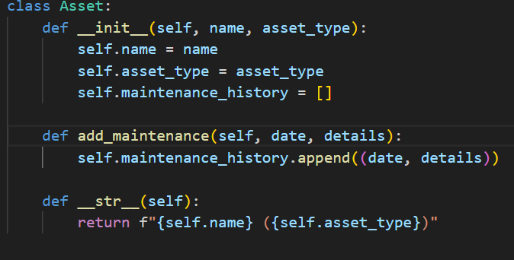
5. Reporting and Analytics:
Asset usage reports
Maintenance and repair tracking
Cost analysis and budgeting
Code:

Slide 9
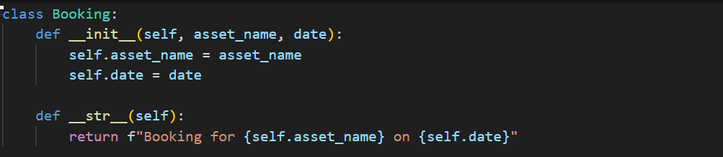
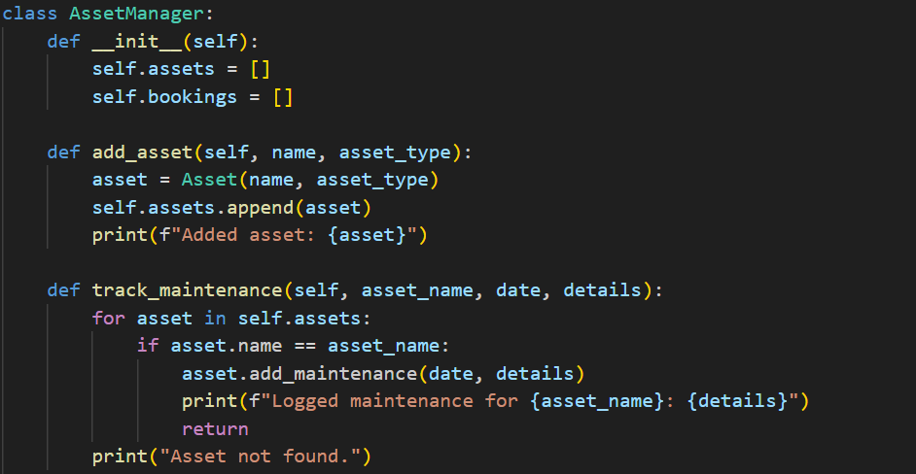

Slide 10
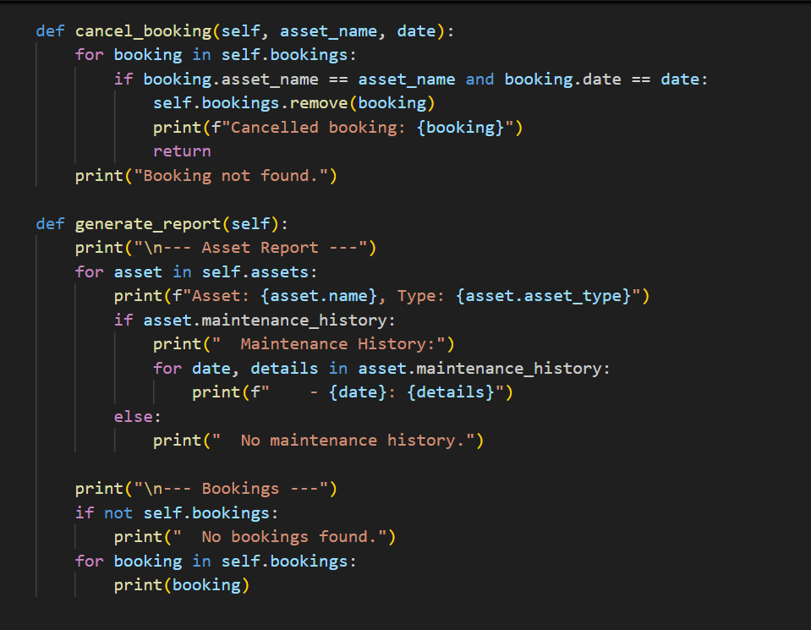

Slide 11
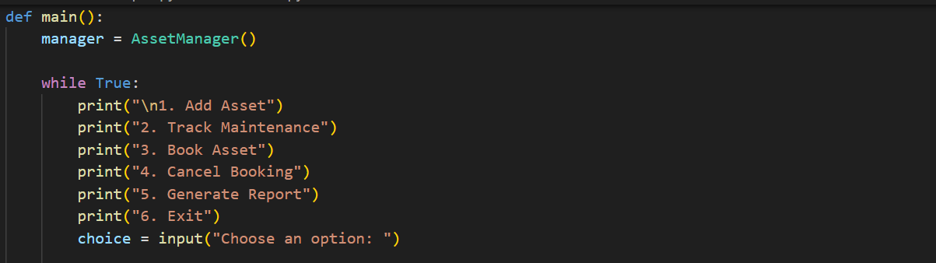

Slide 12
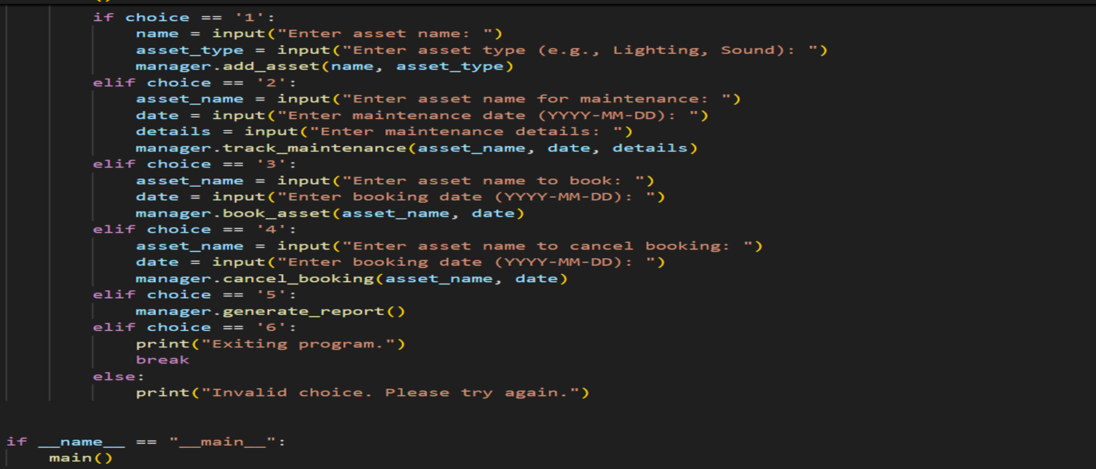

Slide 13
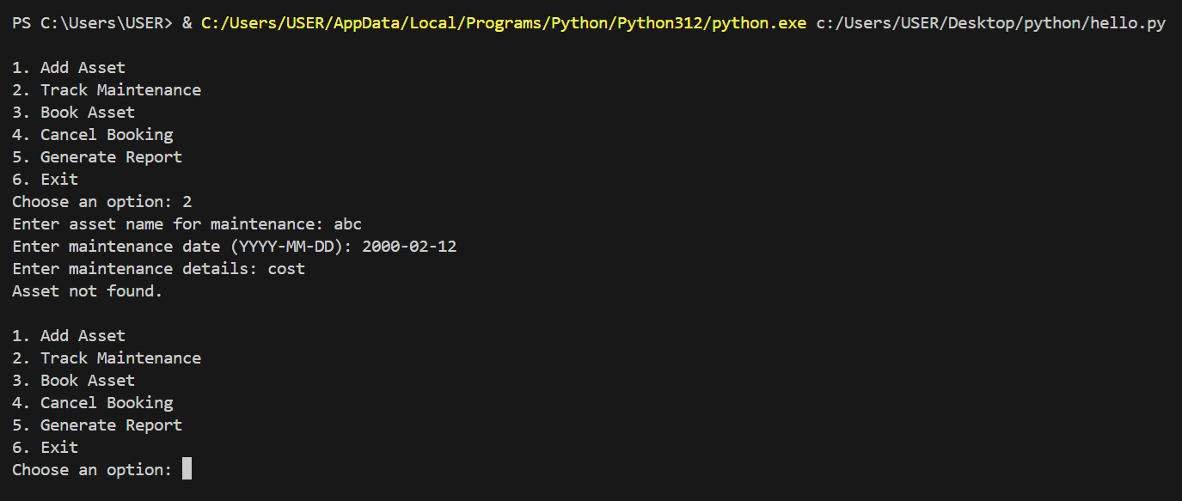
Output:

Slide 14
THANK YOU

